Slide 1
Database management systems
lecture 5. Relational algebra and relational calculus

Slide 2
Introduction
Relational algebra and relational calculus are formal languages associated with the relational model.
Informally, relational algebra is a (high-level) procedural language and relational calculus a non-procedural language.
However, formally both are equivalent to one another.
A language that produces a relation that can be derived using relational calculus is relationally complete.

Slide 3
Relational Algebra
Relational algebra operations work on one or more relations to define another relation without changing the original relations.
Both operands and results are relations, so output from one operation can become input to another operation.
Allows expressions to be nested, just as in arithmetic. This property is called closure.

Slide 4
Relational Algebra
Five basic operations in relational algebra: Selection, Projection, Cartesian product, Union, and Set Difference.
These perform most of the data retrieval operations needed.
Also have Join, Intersection, and Division operations, which can be expressed in terms of 5 basic operations.

Slide 5
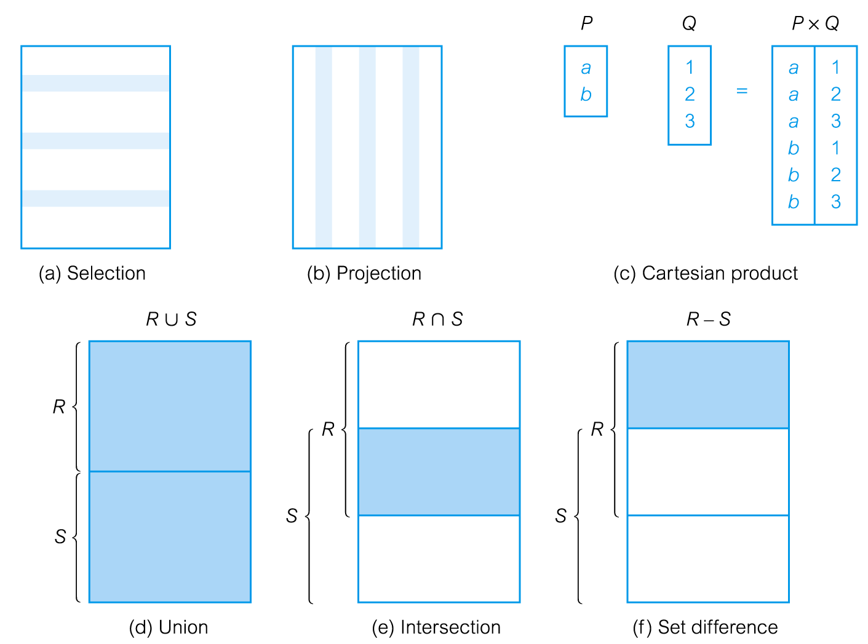
Relational Algebra Operations

Slide 6
Selection (or Restriction)
σ_{predicate} (R)
Works on a single relation R and defines a relation that contains only those tuples (rows) of R that satisfy the specified condition (predicate).

Slide 7
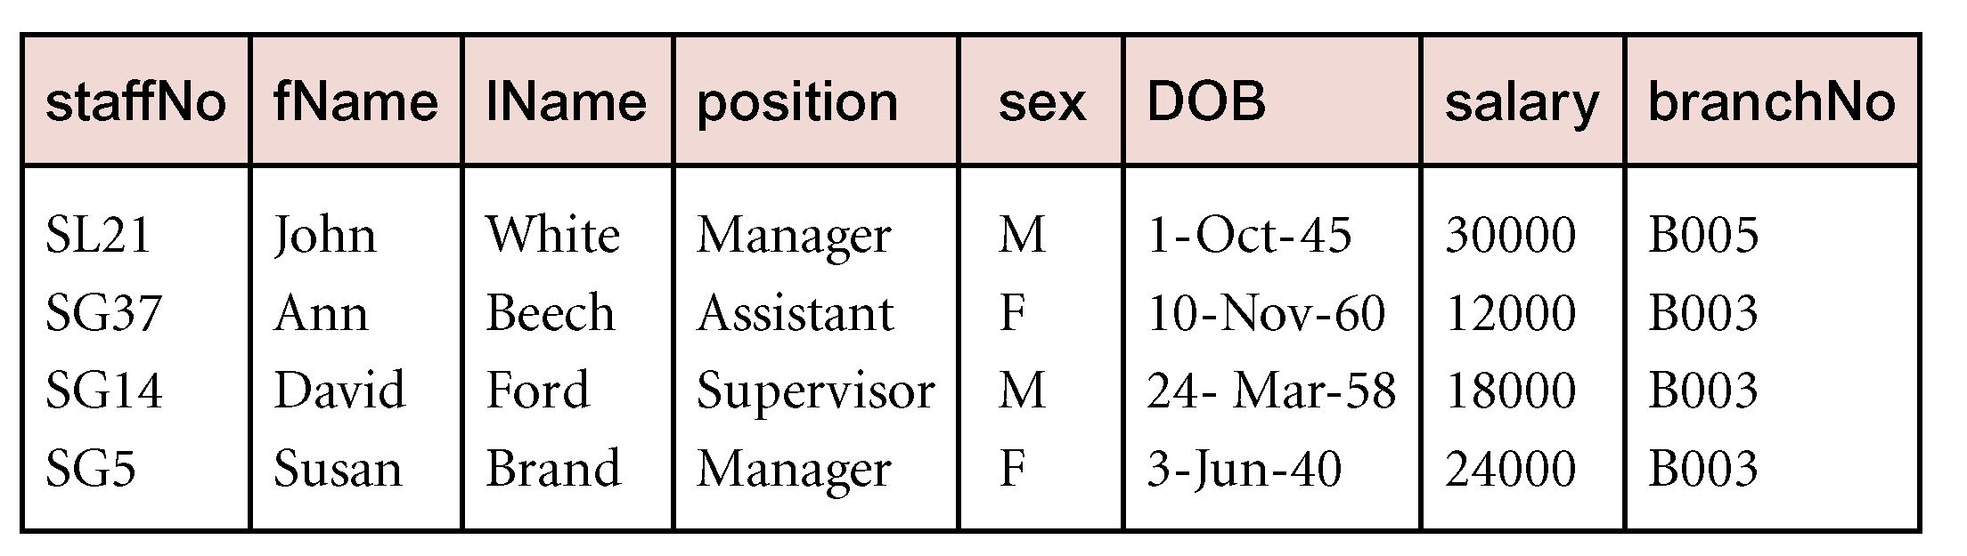
Example - Selection (or Restriction)
List all staff with a salary greater than £10,000.
σ_{salary > 10000} (Staff)

Slide 8
Projection
Π_{col1, . . . , coln}(R)
Works on a single relation R and defines a relation that contains a vertical subset of R, extracting the values of specified attributes and eliminating duplicates.

Slide 9
Projection
Π_{col1, . . . , coln}(R)
Works on a single relation R and defines a relation that contains a vertical subset of R, extracting the values of specified attributes and eliminating duplicates.

Slide 10
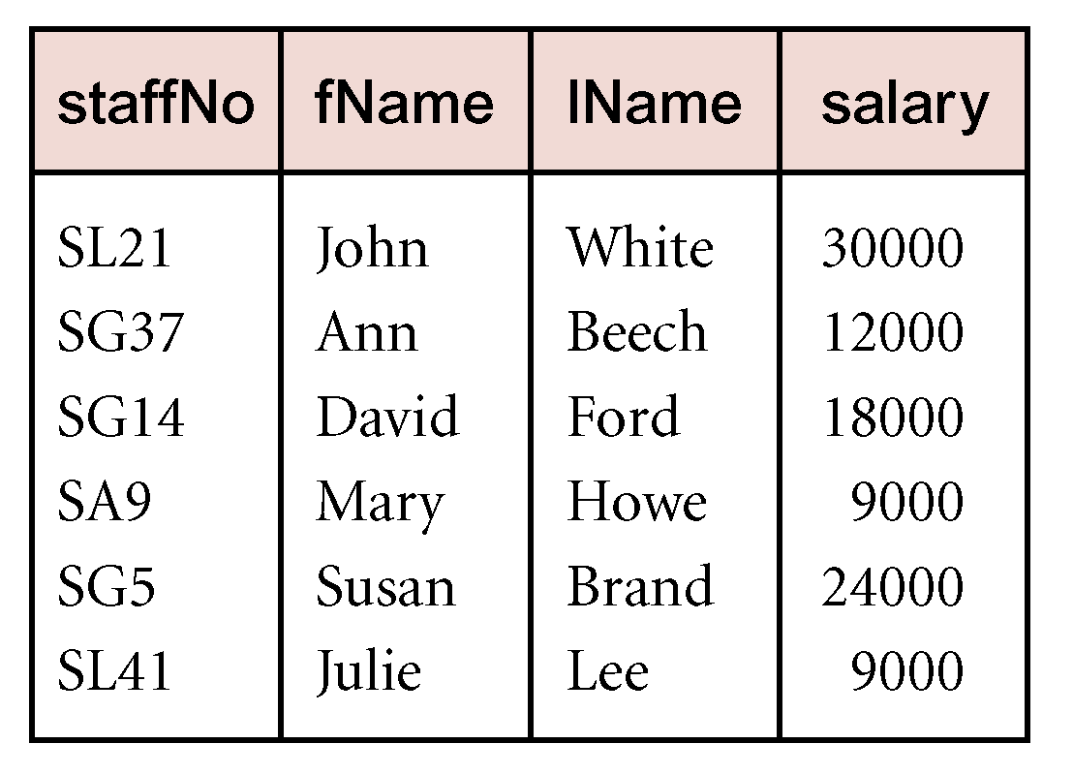
Example - Projection
Produce a list of salaries for all staff, showing only staffNo, fName, lName, and salary details.
Π_{staffNo, fName, lName, salary}(Staff)

Slide 11
Union
R ∪ S
Union of two relations R and S defines a relation that contains all the tuples of R, or S, or both R and S, duplicate tuples being eliminated.
R and S must be union-compatible.
If R and S have I and J tuples, respectively, union is obtained by concatenating them into one relation with a maximum of (I + J) tuples.

Slide 12
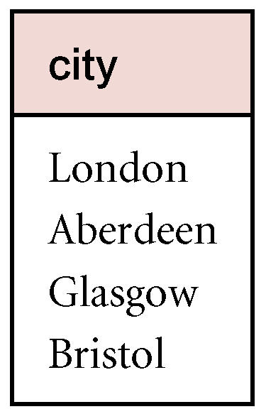
Example - Union
List all cities where there is either a branch office or a property for rent.
Π_{city}(Branch) ∪ Π_{city}(PropertyForRent)
branchNo | bCity | cityID
В004 | Bristol | 1
B003 | Glasgow | 3
В002 | London | 2
propertyNo | pCity | cityID
PA14 | Aberdeen | 4
PL94 | London | 2
PG4 | Glasgow | 3
Таблица 8.1. Branch
Таблица 8.2. PropertyForRent

Slide 13
Set Difference
R – S
Defines a relation consisting of the tuples that are in relation R, but not in S.
R and S must be union-compatible.

Slide 14
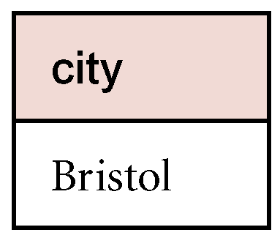
Example - Set Difference
List all cities where there is a branch office but no properties for rent.
Π_{city}(Branch) – Π_{city}(PropertyForRent)
branchNo | bCity | cityID
В004 | Bristol | 1
B003 | Glasgow | 3
В002 | London | 2
propertyNo | pCity | cityID
PA14 | Aberdeen | 4
PL94 | London | 2
PG4 | Glasgow | 3
Таблица 8.1. Branch
Таблица 8.2. PropertyForRent

Slide 15
Intersection
R ∩ S
Defines a relation consisting of the set of all tuples that are in both R and S.
R and S must be union-compatible.
Expressed using basic operations:
R ∩ S = R – (R – S)

Slide 16
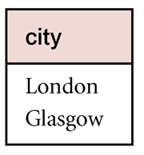
Example - Intersection
List all cities where there is both a branch office and at least one property for rent.
Π_{city}(Branch) ∩ Π_{city}(PropertyForRent)
branchNo | bCity | cityID
В004 | Bristol | 1
B003 | Glasgow | 3
В002 | London | 2
propertyNo | pCity | cityID
PA14 | Aberdeen | 4
PL94 | London | 2
PG4 | Glasgow | 3
Branch
PropertyForRent

Slide 17
Cartesian product
R X S
Defines a relation that is the concatenation of every tuple of relation R with every tuple of relation S.

Slide 18
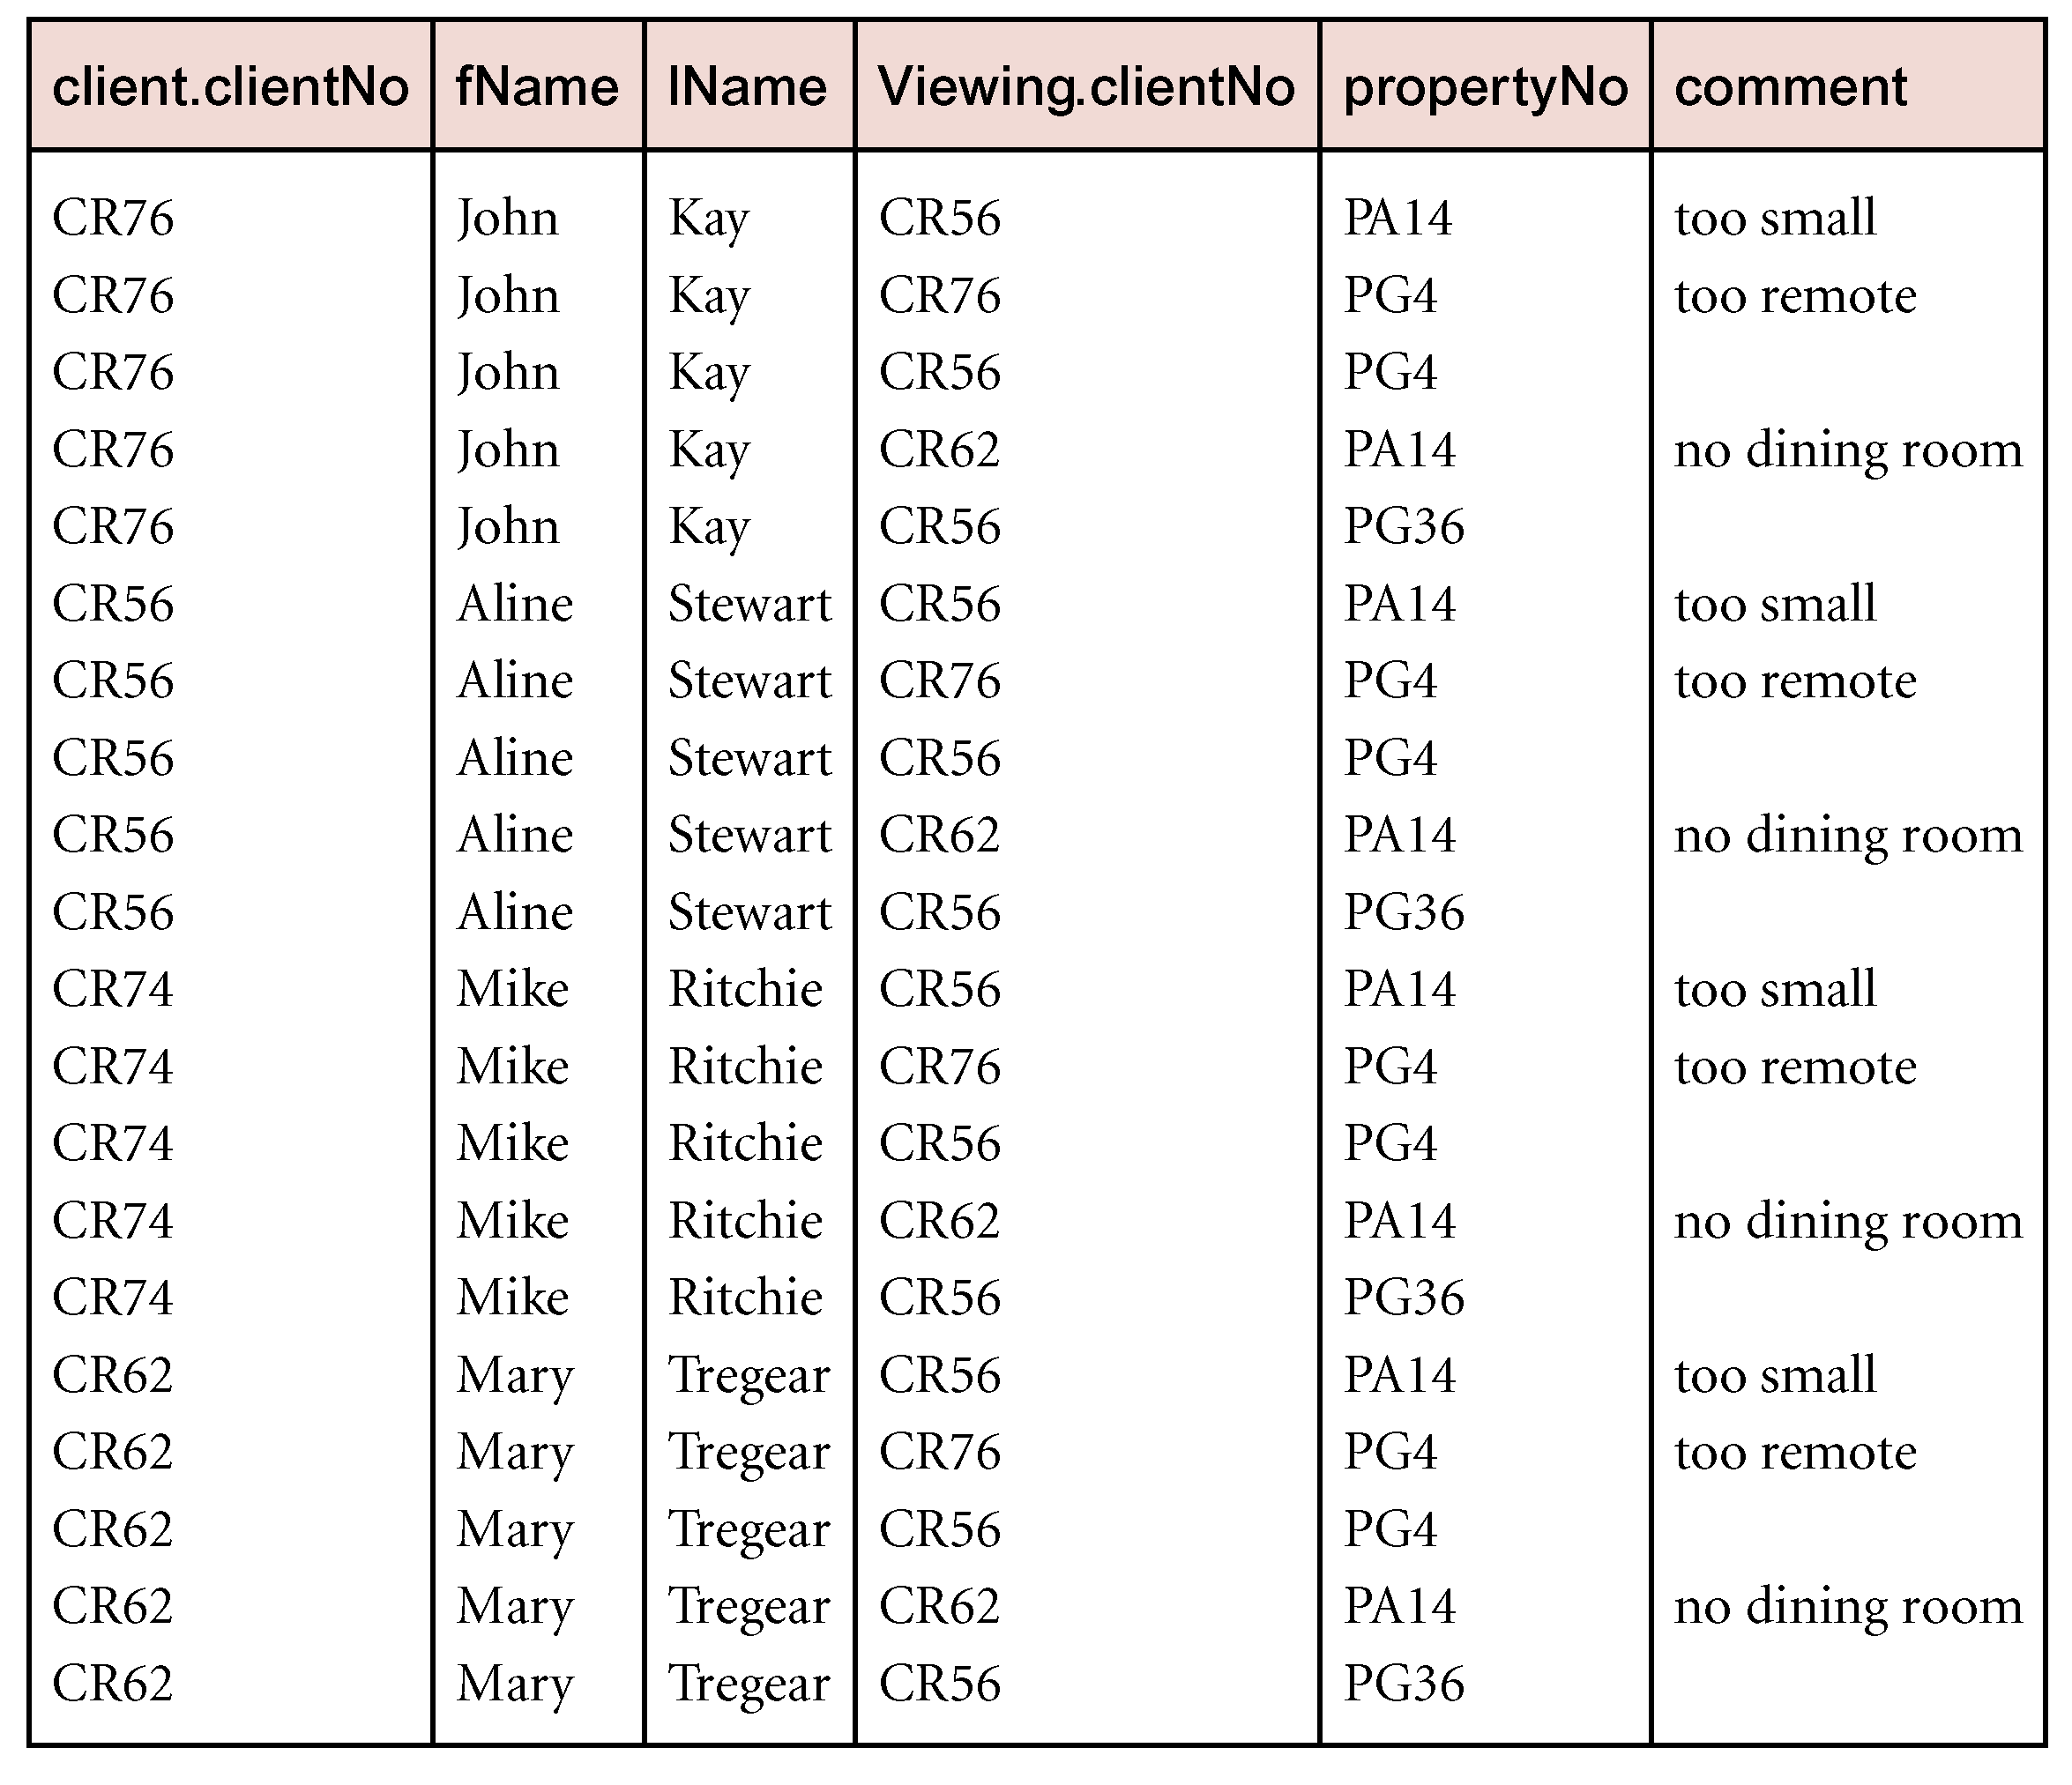
Example - Cartesian product
List the names and comments of all clients who have viewed a property for rent.
(Π_{clientNo, fName, lName}(Client)) X (Π_{clientNo, propertyNo, comment} (Viewing))

Slide 19
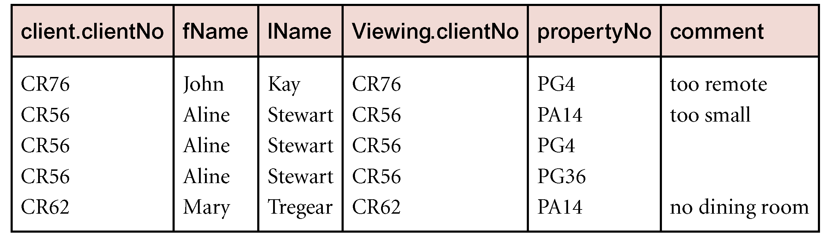
Example - Cartesian product and Selection
Use selection operation to extract those tuples where Client.clientNo = Viewing.clientNo.
σClient.clientNo = Viewing.clientNo((∏_{clientNo, fName, lName}(Client)) Χ (∏_{clientNo, propertyNo, comment}(Viewing)))
Cartesian product and Selection can be reduced to a single operation called a Join.

Slide 20
Join Operations
Join is a derivative of Cartesian product.
Equivalent to performing a Selection, using join predicate as selection formula, over Cartesian product of the two operand relations.
One of the most difficult operations to implement efficiently in an RDBMS and one reason why RDBMSs have intrinsic performance problems.

Slide 21
Join Operations
Various forms of join operation
Theta join
Equijoin (a particular type of Theta join)
Natural join
Outer join
Semijoin

Slide 22
Theta join (θ-join)
R _{F}S
Defines a relation that contains tuples satisfying the predicate F from the Cartesian product of R and S.
The predicate F is of the form R.a_{i} θ S.b_{i} where θ may be one of the comparison operators (<, ≤, >, ≥, =, ≠).

Slide 23
Theta join (θ-join)
Can rewrite Theta join using basic Selection and Cartesian product operations.
R _{F}S = σ_{F}(R Χ S)
Degree of a Theta join is sum of degrees of the operand relations R and S. If predicate F contains only equality (=), the term Equijoin is used.

Slide 24
Example - Equijoin
List the names and comments of all clients who have viewed a property for rent.
(Π_{clientNo, fName, lName}(Client)) Client.clientNo = Viewing.clientNo (Π_{clientNo, propertyNo, comment}(Viewing))

Slide 25
Natural join
R S
An Equijoin of the two relations R and S over all common attributes x. One occurrence of each common attribute is eliminated from the result.

Slide 26
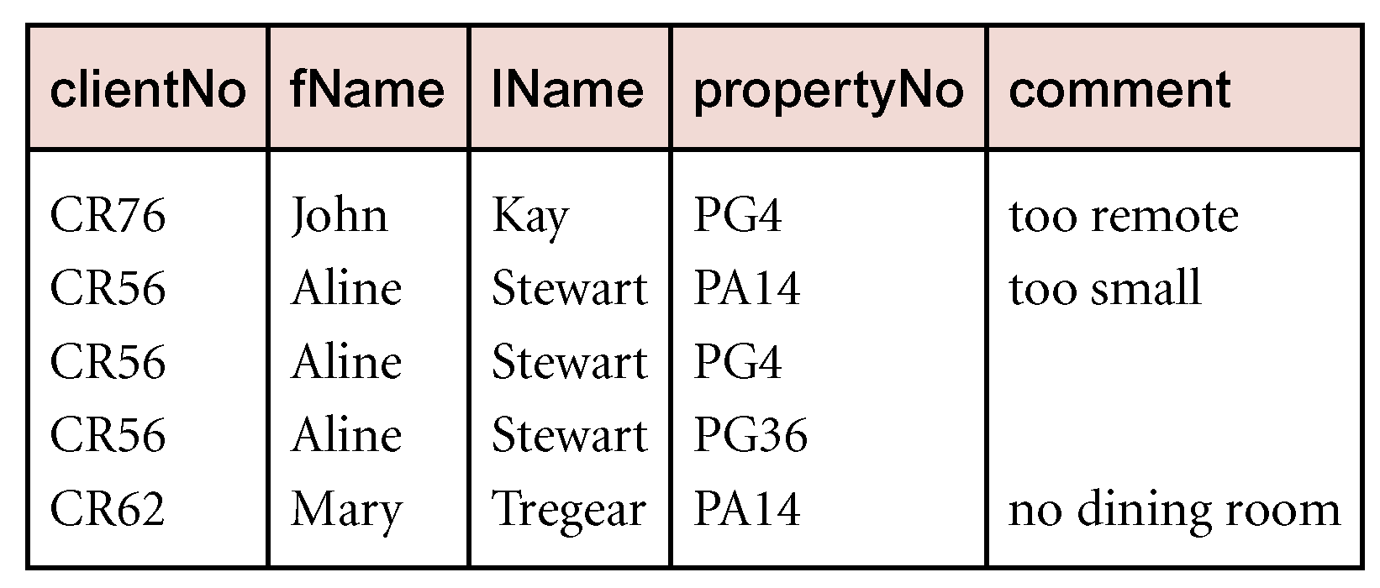
Example
List the names and comments of all clients who have viewed a property for rent.
(Π_{clientNo, fName, lName}(Client))
(Π_{clientNo, propertyNo, comment}(Viewing))

Slide 27
Outer join
To display rows in the result that do not have matching values in the join column, use Outer join.
R S
(Left) outer join is join in which tuples from R that do not have matching values in common columns of S are also included in result relation.

Slide 28
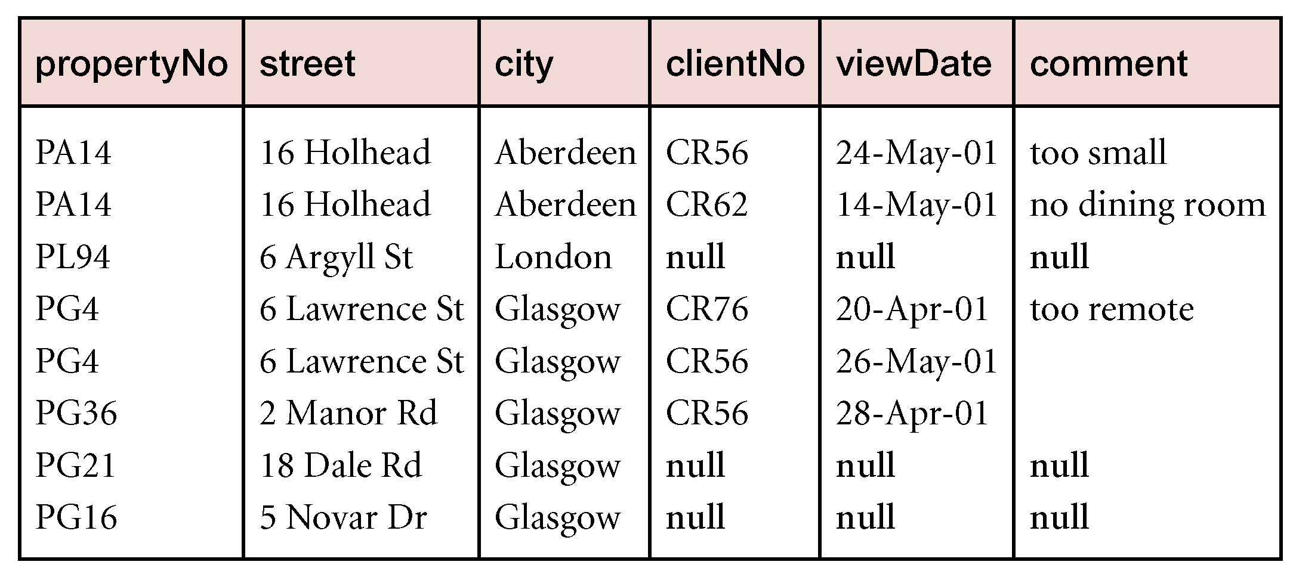
Example - Left Outer join
Produce a status report on property viewings.
Π_{propertyNo, street, city}(PropertyForRent) Viewing

Slide 29
Semijoin
R _{F} S
Defines a relation that contains the tuples of R that participate in the join of R with S.
Can rewrite Semijoin using Projection and Join:
R _{F} S = Π_{A}(R _{F} S)

Slide 30
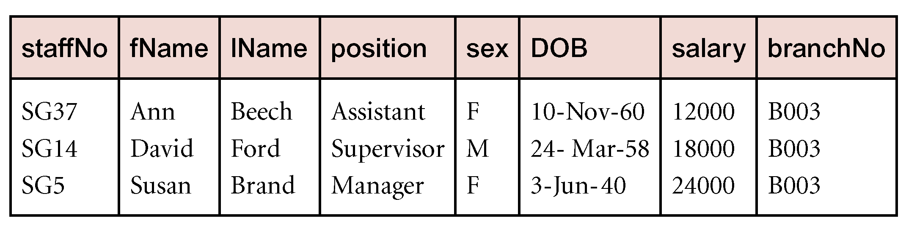
Example - Semijoin
List complete details of all staff who work at the branch in Glasgow.
Staff _{Staff.branchNo=Branch.branchNo}(σ_{city=‘Glasgow’}(Branch))

Slide 31
Division
R ÷ S
Defines a relation over the attributes C that consists of set of tuples from R that match combination of every tuple in S.
Expressed using basic operations:
T₁ ← Π_{C}(R)
T₂ ← Π_{C}((S X T₁) – R)
T ← T₁ – T₂

Slide 32
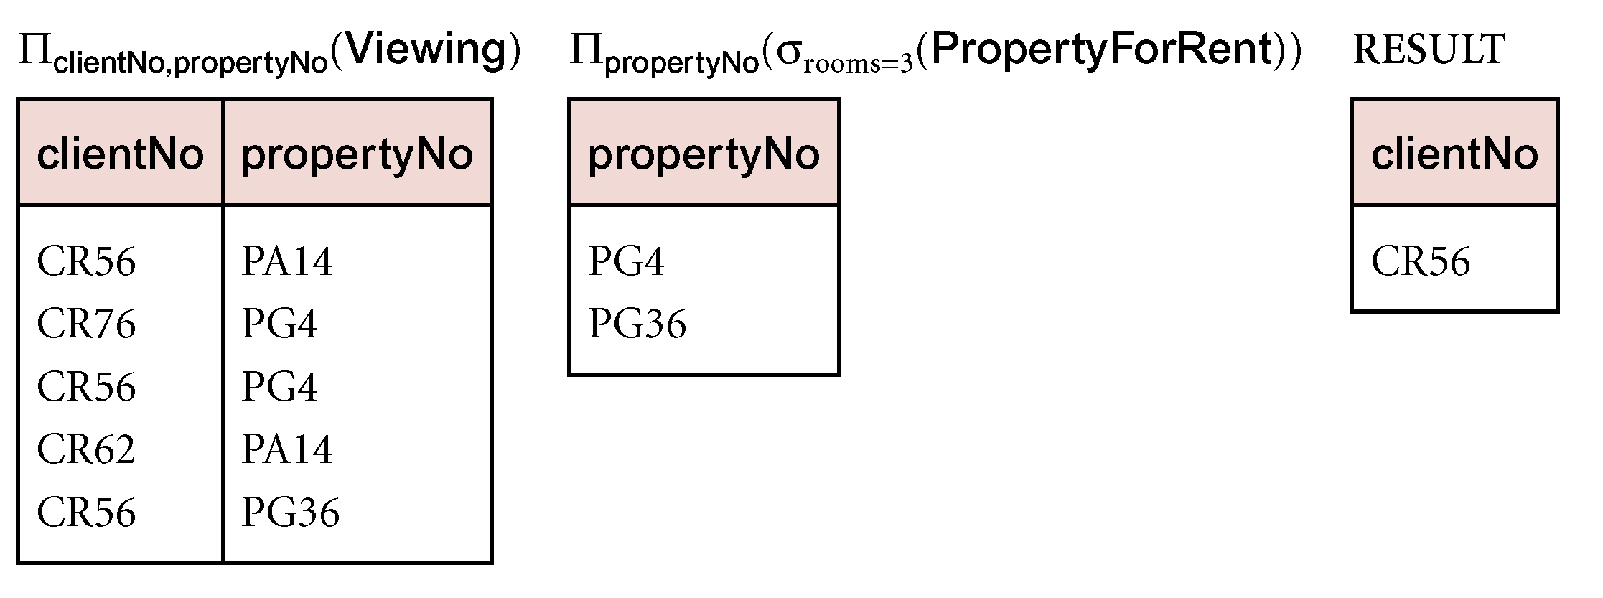
Example - Division
Identify all clients who have viewed all properties with three rooms.
(Π_{clientNo, propertyNo}(Viewing)) ÷
(Π_{propertyNo}(σ_{rooms = 3} (PropertyForRent)))

Slide 33
Relational Calculus
Relational calculus query specifies what is to be retrieved rather than how to retrieve it.
No description of how to evaluate a query.
In first-order logic (or predicate calculus), predicate is a truth-valued function with arguments.
When we substitute values for the arguments, function yields an expression, called a proposition, which can be either true or false.

Slide 34
Relational Calculus
If predicate contains a variable (e.g. ‘x is a member of staff’), there must be a range for x.
When we substitute some values of this range for x, proposition may be true; for other values, it may be false.
When applied to databases, relational calculus has forms: tuple and domain.

Slide 35
Tuple Relational Calculus
Interested in finding tuples for which a predicate is true. Based on use of tuple variables.
Tuple variable is a variable that ‘ranges over’ a named relation: i.e., variable whose only permitted values are tuples of the relation.
Specify range of a tuple variable S as the Staff relation as:
Staff(S)
To find set of all tuples S such that P(S) is true:
{S | P(S)}

Slide 36
Tuple Relational Calculus - Example
To find details of all staff earning more than £10,000:
{S | Staff(S) ∧ S.salary > 10000}
To find a particular attribute, such as salary, write:
{S.salary | Staff(S) ∧ S.salary > 10000}

Slide 37
Tuple Relational Calculus
Can use two quantifiers to tell how many instances the predicate applies to:
Existential quantifier ∃ (‘there exists’)
Universal quantifier ∀ (‘for all’)
Tuple variables qualified by ∀ or ∃ are called bound variables, otherwise called free variables.

Slide 38
Tuple Relational Calculus
Existential quantifier used in formulae that must be true for at least one instance, such as:
Staff(S) ∧ (∃B)(Branch(B) ∧
(B.branchNo = S.branchNo) ∧ B.city = ‘London’)
Means ‘There exists a Branch tuple with same branchNo as the branchNo of the current Staff tuple, S, and is located in London’.

Slide 39
Tuple Relational Calculus
Universal quantifier is used in statements about every instance, such as:
(∀B) (B.city ≠ ‘Paris’)
Means ‘For all Branch tuples, the address is not in Paris’.
Can also use ~(∃B) (B.city = ‘Paris’) which means ‘There are no branches with an address in Paris’.

Slide 40
Tuple Relational Calculus
Formulae should be unambiguous and make sense.
A (well-formed) formula is made out of atoms:
R(S_{i}), where S_{i} is a tuple variable and R is a relation
S_{i}.a₁ θ S_{j}.a₂
S_{i}.a₁ θ c
Can recursively build up formulae from atoms:
An atom is a formula
If F₁ and F₂ are formulae, so are their conjunction, F₁ ∧ F₂; disjunction, F₁ ∨ F₂; and negation, ~F₁
If F is a formula with free variable X, then (∃X)(F) and (∀X)(F) are also formulae.

Slide 41
Example - Tuple Relational Calculus
List the names of all managers who earn more than £25,000.
{S.fName, S.lName | Staff(S) ∧
S.position = ‘Manager’ ∧ S.salary > 25000}
List the staff who manage properties for rent in Glasgow.
{S | Staff(S) ∧ (∃P) (PropertyForRent(P) ∧ (P.staffNo = S.staffNo) ∧ P.city = ‘Glasgow’)}

Slide 42
Example - Tuple Relational Calculus
List the names of staff who currently do not manage any properties.
{S.fName, S.lName | Staff(S) ∧ (~(∃P) (PropertyForRent(P)∧(S.staffNo = P.staffNo)))}
Or
{S.fName, S.lName | Staff(S) ∧ ((∀P) (~PropertyForRent(P) ∨
~(S.staffNo = P.staffNo)))}

Slide 43
Example - Tuple Relational Calculus
List the names of clients who have viewed a property for rent in Glasgow.
{C.fName, C.lName | Client(C) ∧ ((∃V)(∃P)
(Viewing(V) ∧ PropertyForRent(P) ∧
(C.clientNo = V.clientNo) ∧
(V.propertyNo=P.propertyNo) ∧
P.city =‘Glasgow’))}

Slide 44
Tuple Relational Calculus
Expressions can generate an infinite set. For example:
{S | ~Staff(S)}
To avoid this, add restriction that all values in result must be values in the domain of the expression.

Slide 45
Domain Relational Calculus
Uses variables that take values from domains instead of tuples of relations.
If F(d₁, d₂, . . . , d_{n}) stands for a formula composed of atoms and d₁, d₂, . . . , d_{n} represent domain variables, then:
{d₁, d₂, . . . , d_{n} | F(d₁, d₂, . . . , d_{n})}
is a general domain relational calculus expression.

Slide 46
Example - Domain Relational Calculus
Find the names of all managers who earn more than £25,000.
{fN, lN | (∃sN, posn, sex, DOB, sal, bN)
(Staff (sN, fN, lN, posn, sex, DOB, sal, bN) ∧
posn = ‘Manager’ ∧ sal > 25000)}

Slide 47
Example - Domain Relational Calculus
List the staff who manage properties for rent in Glasgow.
{sN, fN, lN, posn, sex, DOB, sal, bN |
(∃sN1,cty)(Staff(sN,fN,lN,posn,sex,DOB,sal,bN) ∧
PropertyForRent(pN, st, cty, pc, typ, rms,
rnt, oN, sN1, bN1) ∧
(sN=sN1) ∧ cty=‘Glasgow’)}

Slide 48
Example - Domain Relational Calculus
List the names of staff who currently do not manage any properties for rent.
{fN, lN | (∃sN)
(Staff(sN,fN,lN,posn,sex,DOB,sal,bN) ∧
(~(∃sN1) (PropertyForRent(pN, st, cty, pc, typ,
rms, rnt, oN, sN1, bN1) ∧ (sN=sN1))))}

Slide 49
Example - Domain Relational Calculus
List the names of clients who have viewed a property for rent in Glasgow.
{fN, lN | (∃cN, cN1, pN, pN1, cty)
(Client(cN, fN, lN,tel, pT, mR) ∧
Viewing(cN1, pN1, dt, cmt) ∧
PropertyForRent(pN, st, cty, pc, typ,
rms, rnt,oN, sN, bN) ∧
(cN = cN1) ∧ (pN = pN1) ∧ cty = ‘Glasgow’)}

Slide 50
Domain Relational Calculus
When restricted to safe expressions, domain relational calculus is equivalent to tuple relational calculus restricted to safe expressions, which is equivalent to relational algebra.
Means every relational algebra expression has an equivalent relational calculus expression, and vice versa.

Slide 51
Other Languages
Transform-oriented languages are non-procedural languages that use relations to transform input data into required outputs (e.g. SQL).
Graphical languages provide user with picture of the structure of the relation. User fills in example of what is wanted and system returns required data in that format (e.g. QBE).

Slide 52
Other Languages
4GLs can create complete customized application using limited set of commands in a user-friendly, often menu-driven environment.
Some systems accept a form of natural language, sometimes called a 5GL, although this development is still at an early stage.

